Slide 1
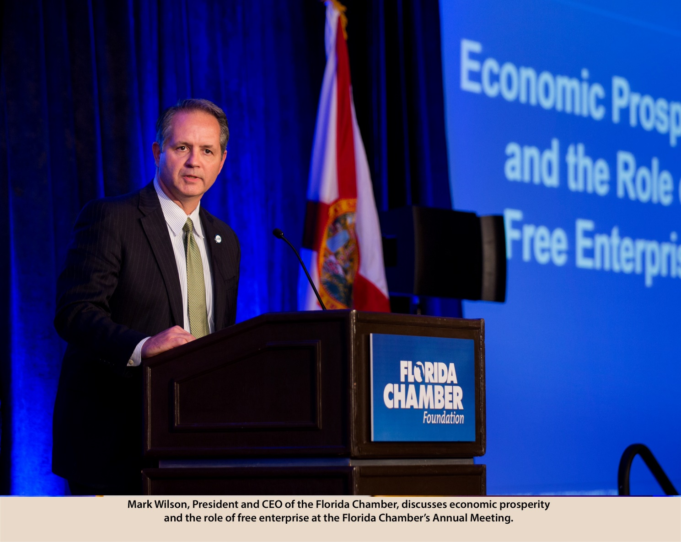
Mark
Wilson
—
President & CEO
Florida Chamber of Commerce
MWilson@FLChamber.com

Slide 2
“Florida is changing. Our economics, our demographics and our politics are all changing and these changes are both opportunities and challenges.” – Mark Wilson
mwilson@flchamber.com

Slide 3
Early Learning
K-12
Post-Secondary Education
Workforce Training

Slide 4
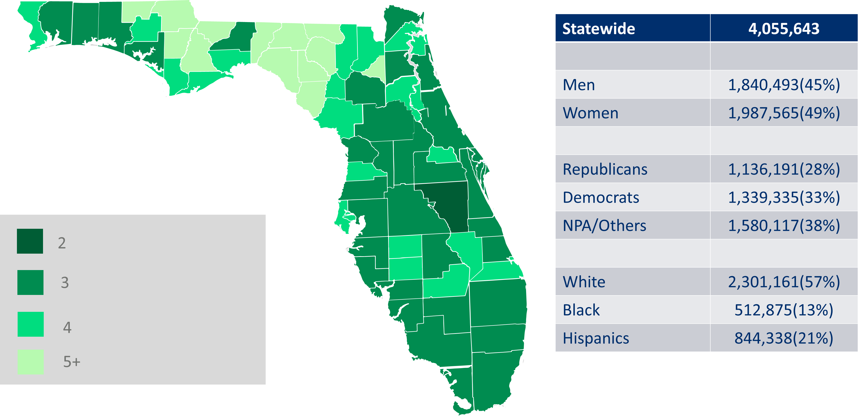
Scott Era: New Voters
Map Shaded by
Total Voters/New Voters

Slide 6
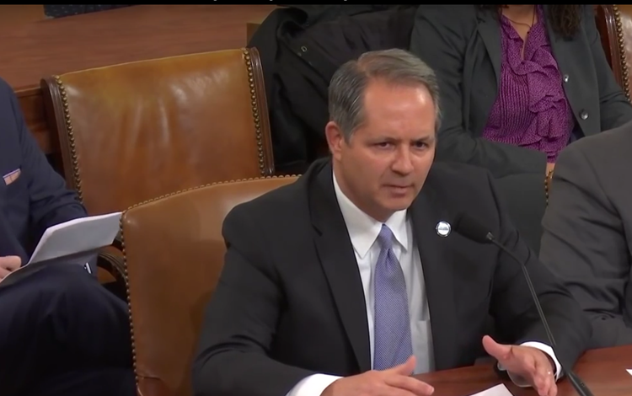
“Talent is quickly replacing the tax incentive as the economic tool of choice.” – Mark Wilson

Slide 7
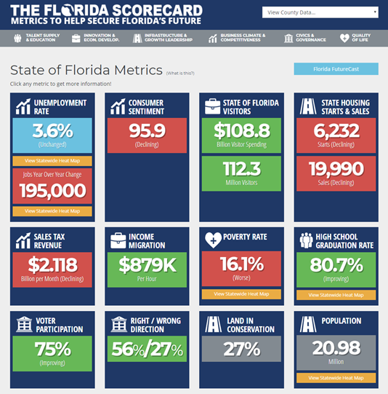
Florida At A Glance
Florida’s Economy $964.9 Billion GDP (16th / $1T by 2018)
20.98 Million Residents (3rd / +5.4M by 2030 / +898/day)
Florida creates 1 out of every 10 jobs in the U.S.
112.3 Million Visitors in 2016
3.6% Unemployment Rate

Slide 8
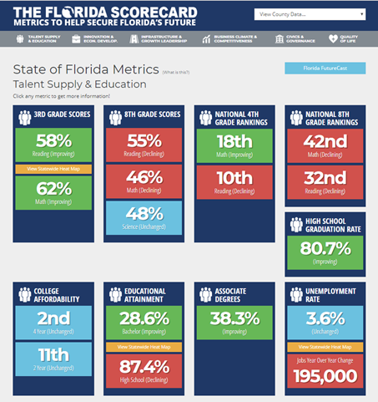
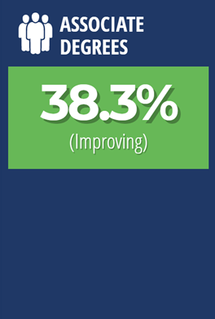
Improving Education For A Better Workforce
36.7% of Floridians had at least an associate’s degree or higher in 2016
27.3% of Floridians had at least a bachelor’s degree or higher in 2016

Slide 9
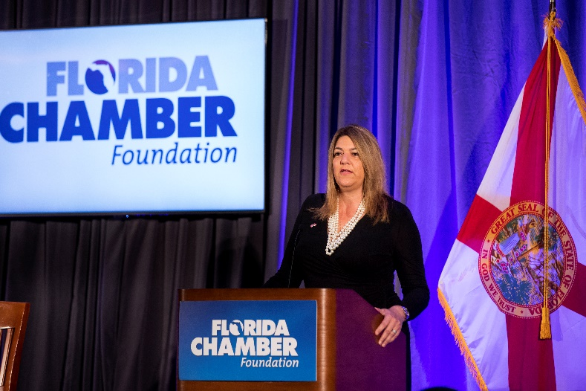
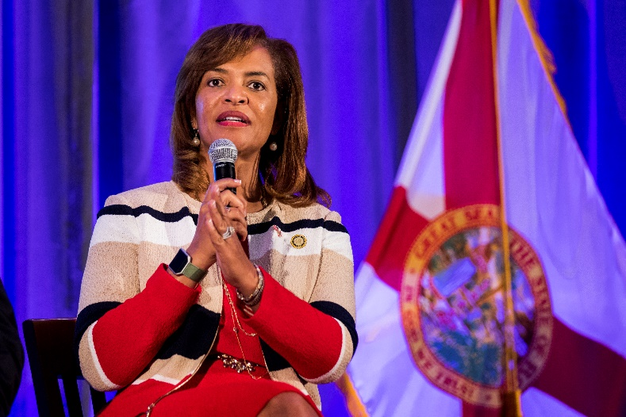
2018 Learners To Earners
Chancellor Madeline Pumariega, Senior VP and Chief Policy Officer, Helios Education Foundation
Ava Parker, President, Palm Beach State College
Jim Murdough, President, Tallahassee Community College
June 11-12 in Tampa

Slide 10
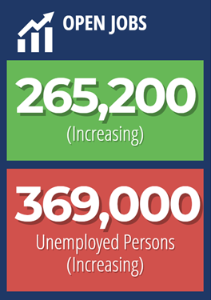
Talent is an Advantage and a Risk
Notes:
Edit themes.

Slide 11
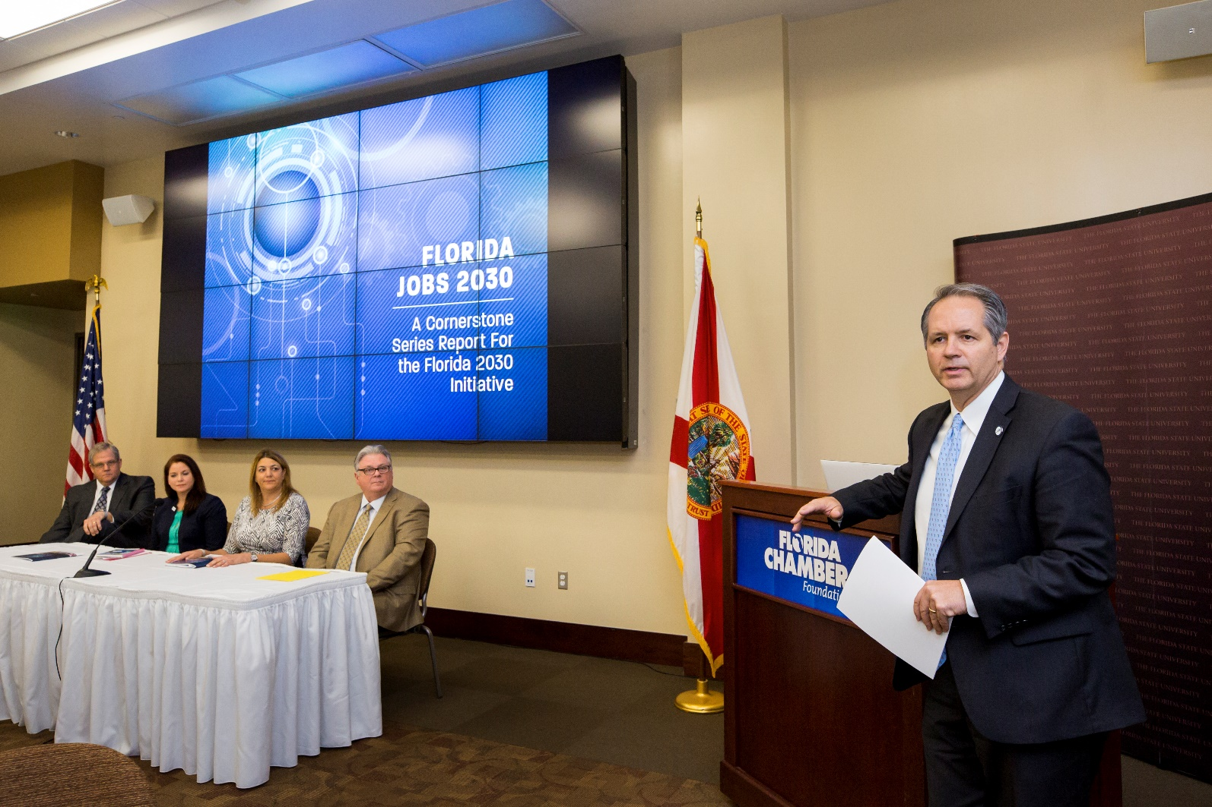
Jobs For The Future: 2 Million

Slide 12
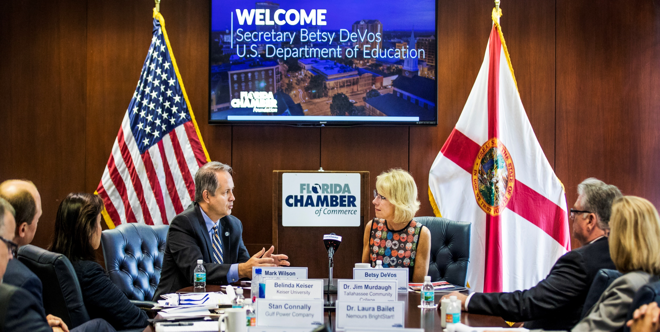

Slide 13
mwilson@flchamber.com

